Slide 1
AI in Ophthalmology

Slide 2
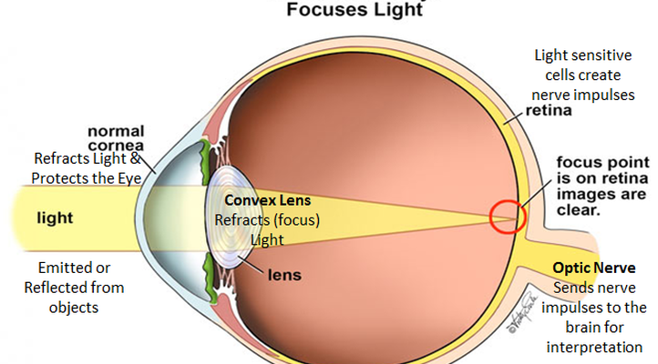
Structure of Human Eye
The part of the eye which senses the light is called Retina.
- The Macula is responsible for high- definition color Vision.
Retina is super complex tissue packing several cells together.
-It has ten different tissue layers.

Slide 3
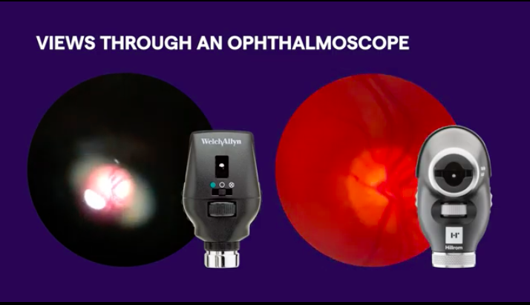
Ophthalmoscope
Invented by Hermann von Helmholtz in 1851.
It is used to detect and evaluate symptoms of retinal detachment or eye disease.
- the fundus in Latin means bottom or back end.

Slide 4
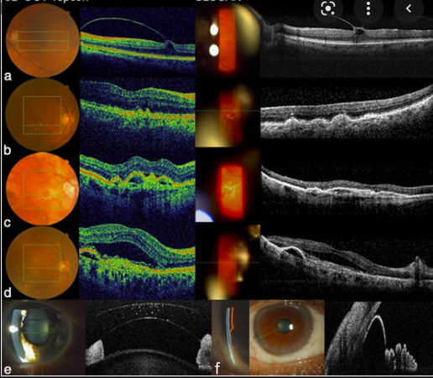
optical coherence tomography (OCT)
It was invented by David Huang in 1991.
OCT uses the light to scan the structure in the back of the eye.
used to obtain high resolution cross-sectional images of the retina
generates three-dimensional views of the retina
It also helps doctors to detect the changes in the eye
diagnosis of retinal diseases in the early detection

Slide 5
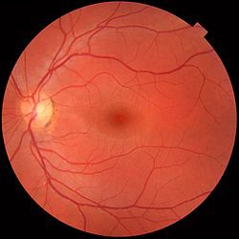
Guess whose Retina?

Slide 6
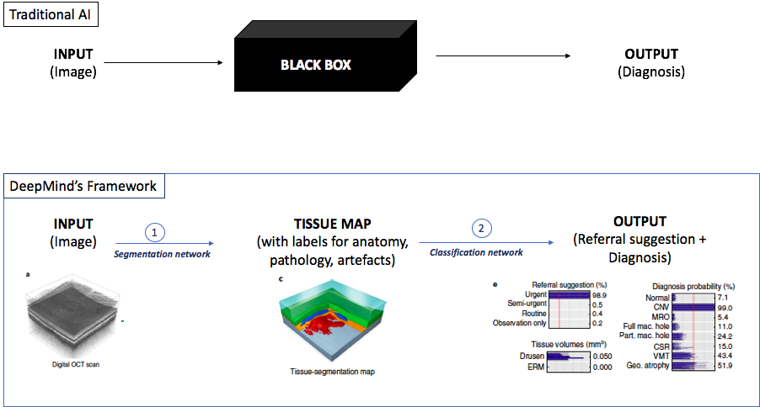
AI Processing

Slide 7
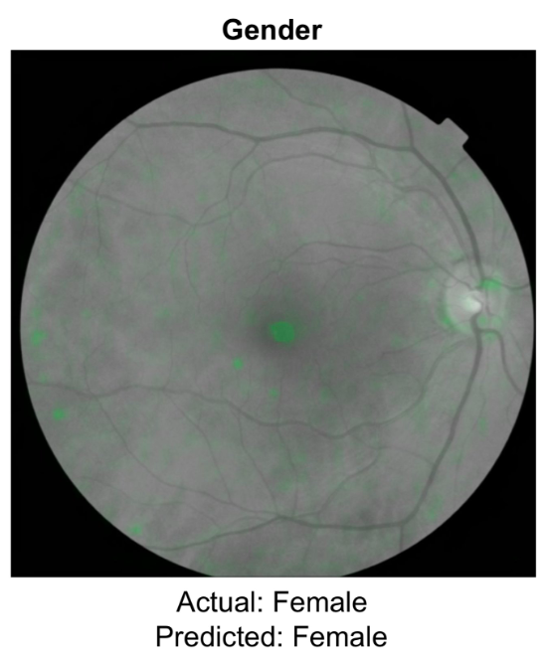
soft attention heat map is overlain in green, indicating the areas of the heat map that the neural-network model is using to make the gender prediction for the image.

Slide 8
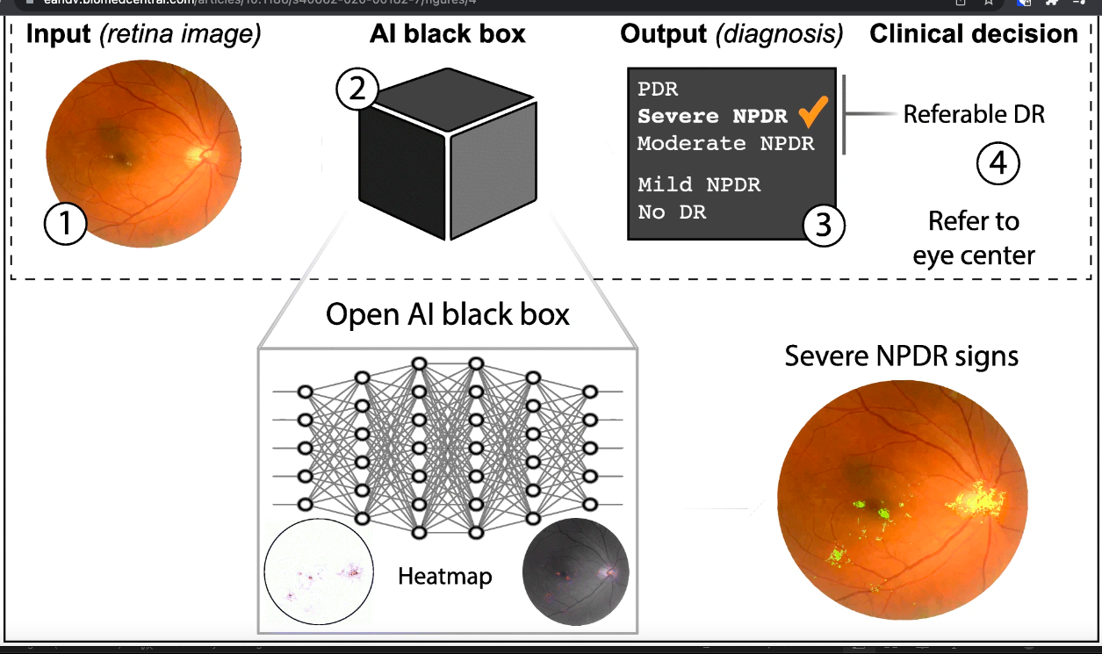
AI in Diabetes Detection

Slide 9
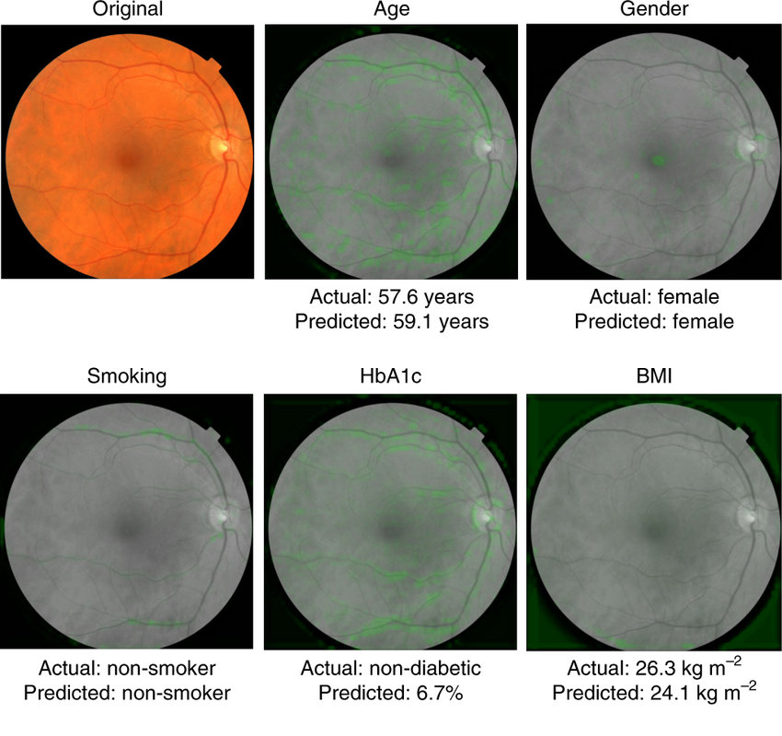

Slide 10


